Slide 1
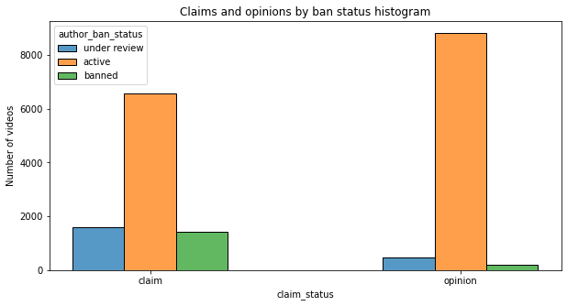
Executive summary
Milestone 3 of the TikTok Claims Classification Project
Project Overview
Create a predictive model that can determine whether a video contains a claim or offers an opinion. In this phase, we conducted an exploratory data analysis on the dataset.
The number of not-verified users is really high on the platform. Claim videos are more likely to come from a not-verified user. Nevertheless, it seems that there's no relation between being a not-verified user and uploading claim videos.
Active users are the majority on the platform, regardless of the video's nature. Anyway, claim videos are more likely to come from banned or under-review users.
Banned authors are the most watched on the platform, followed by under-review authors.’
99% of the views come from claim videos.
It's necessary to make a decision about the outliers; my recommendation is to leave them. That will help the machine learning model understand the natural behavior of social media and viral videos.
Inform the stakeholders about the state of the data.

